Slide 1
Speech Recognizer
Kseniya Bout
Nick Halliwell
Aina Lopez
Yaroslav Marchuk

Slide 2
Index
Introduction
Data and Speech Recognition
Dynamic Time Warping (DTW)
Algorithm
Conditions
Speech Recognizer
Conclusions

Slide 3
INTRODUCTION
We are interested in recognizing speech (words “Google” and “Facebook”) .
We find that it is done by Dynamic Time Warping algorithm (Dynamic Programming).
We learn its theory and applications.
We implement this all in R. We record words, we extract features, we write DTW algorithm, we obtain successful results.
We enjoy the speech recognition!

Slide 4

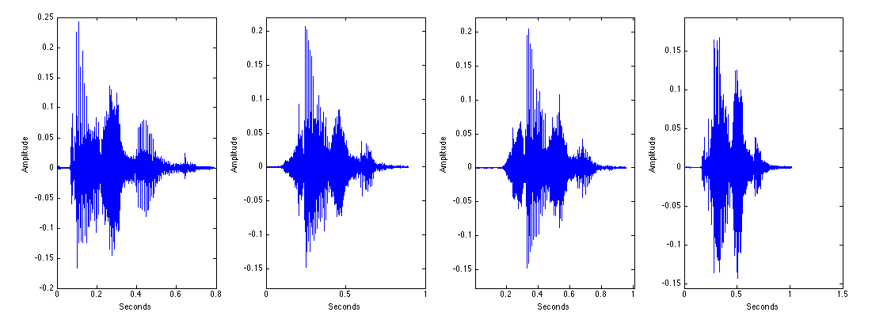

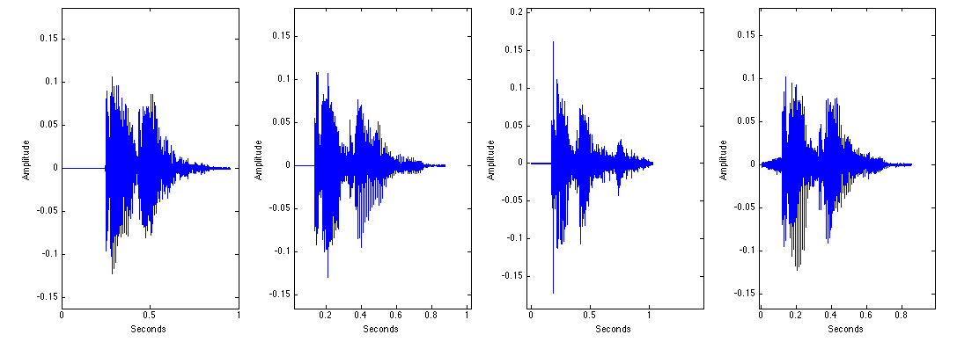
Data
We have sound files with the words Google and Facebook.
Sound Waves are non-stationary.
We can’t compare non-stationary signals (directly).
Solution? → Apply speech processing techniques

Slide 5
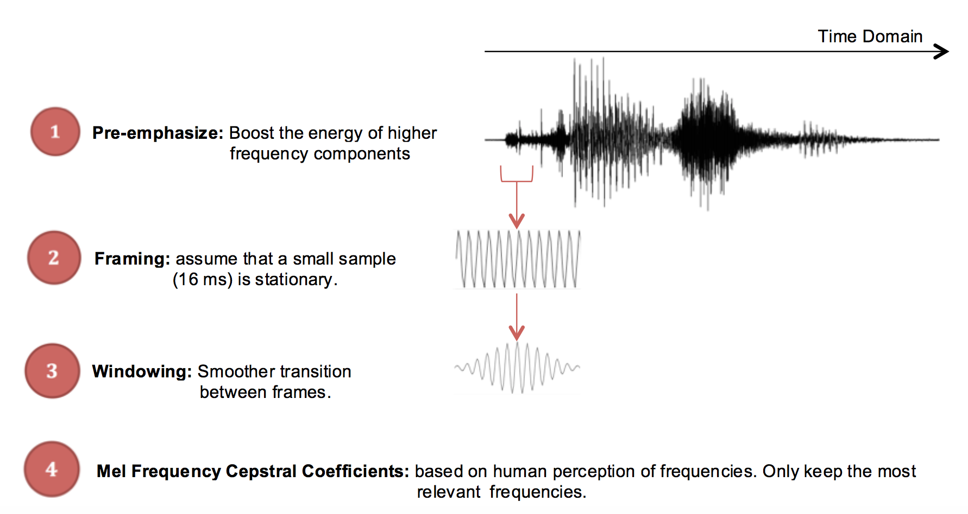
Speech Processing

Slide 6
Dynamic Time Warping: Intuition
i
i
i
i
i+2
time
time
* Images From: http://www.psb.ugent.be/cbd/papers/gentxwarper/DTWalgorithm.htm

Slide 7
Dynamic Time Warping: Algorithm
Time Series A
There are a lot of possible warping paths through the grid.
1
i_{s}
n
m
reduction of the search space
Restrictions on the warping function:
monotonicity
continuity
boundary conditions
warping window
slope constraint.
j_{s}
Time Series B
1
* Images From: http://www.psb.ugent.be/cbd/papers/gentxwarper/DTWalgorithm.htm

Slide 8
Dynamic Time Warping: Algorithm
Time Series A
1
i
n
m
DP-equation:
g(i, j – 1) + d(i, j)
g(i, j) = min g(i – 1, j – 1) + 2d(i, j)
g(i – 1, j) + d(i, j)
i = j - r
j
Time Series B
1
i = j + r
* Images From: http://www.psb.ugent.be/cbd/papers/gentxwarper/DTWalgorithm.htm

Slide 9
Speech/Word RECOGNIZER
Templates
G1
G2
F1
F2
Feature extraction
Feature extraction
Feature extraction
Feature extraction
Test
Feature extraction
Dynamic Time Warping
Minimum
distance

Slide 10
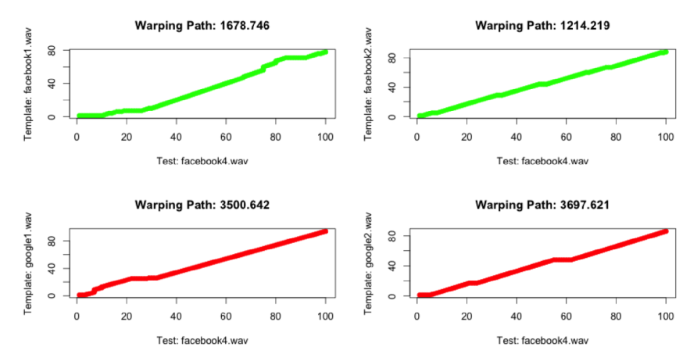
Results

Slide 11
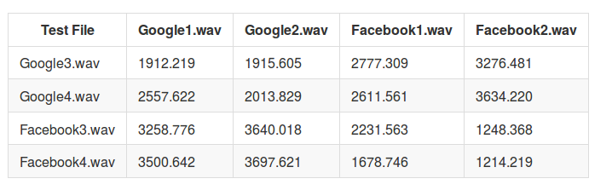
Results
Same voice in test and templates

Slide 12
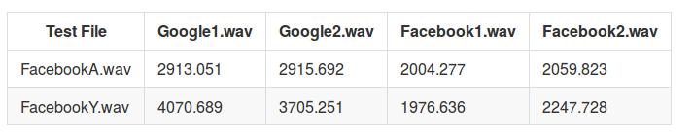
Results
Different voices

Slide 13
Conclusions
DTW is fast and accurate.
The recognizer is robust to gender and works well on individual words
We don’t have enough data to make universal claims at this time.
TO DO’s:
More template data.
Test it with sentences.
From R, we were not able to import voices in real time, this would add a unique capability to our algorithm.

Slide 14


